Slide 1

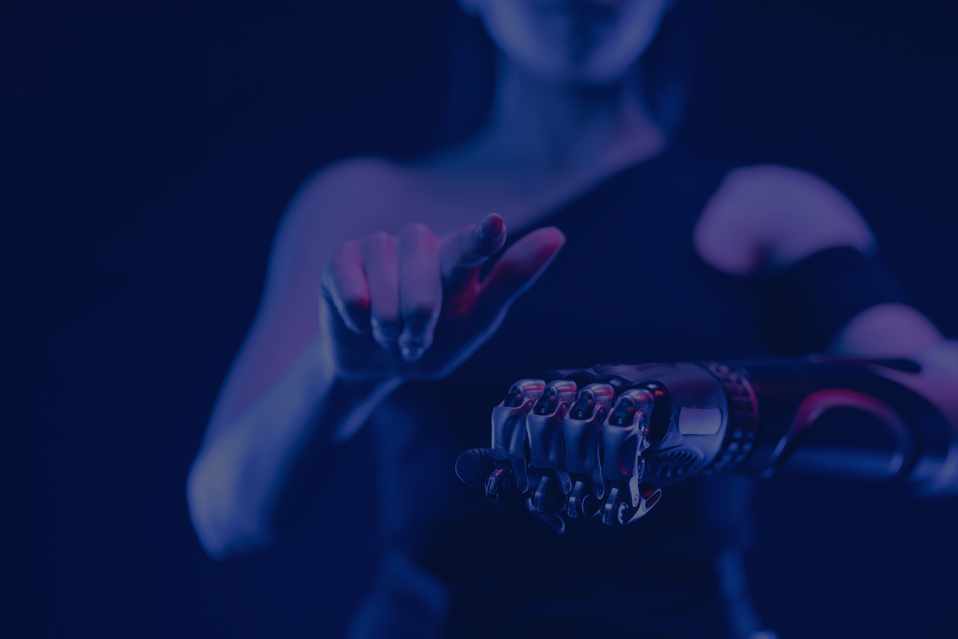
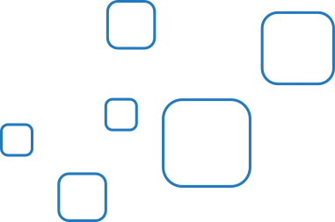

Artificial
Intelligence
Title: TumorTrace: MRI-Based AI for Breast Cancer Detection
Name: Suyash Panchal
Theme : AI First
Platform : Infosys Springboard

Slide 2
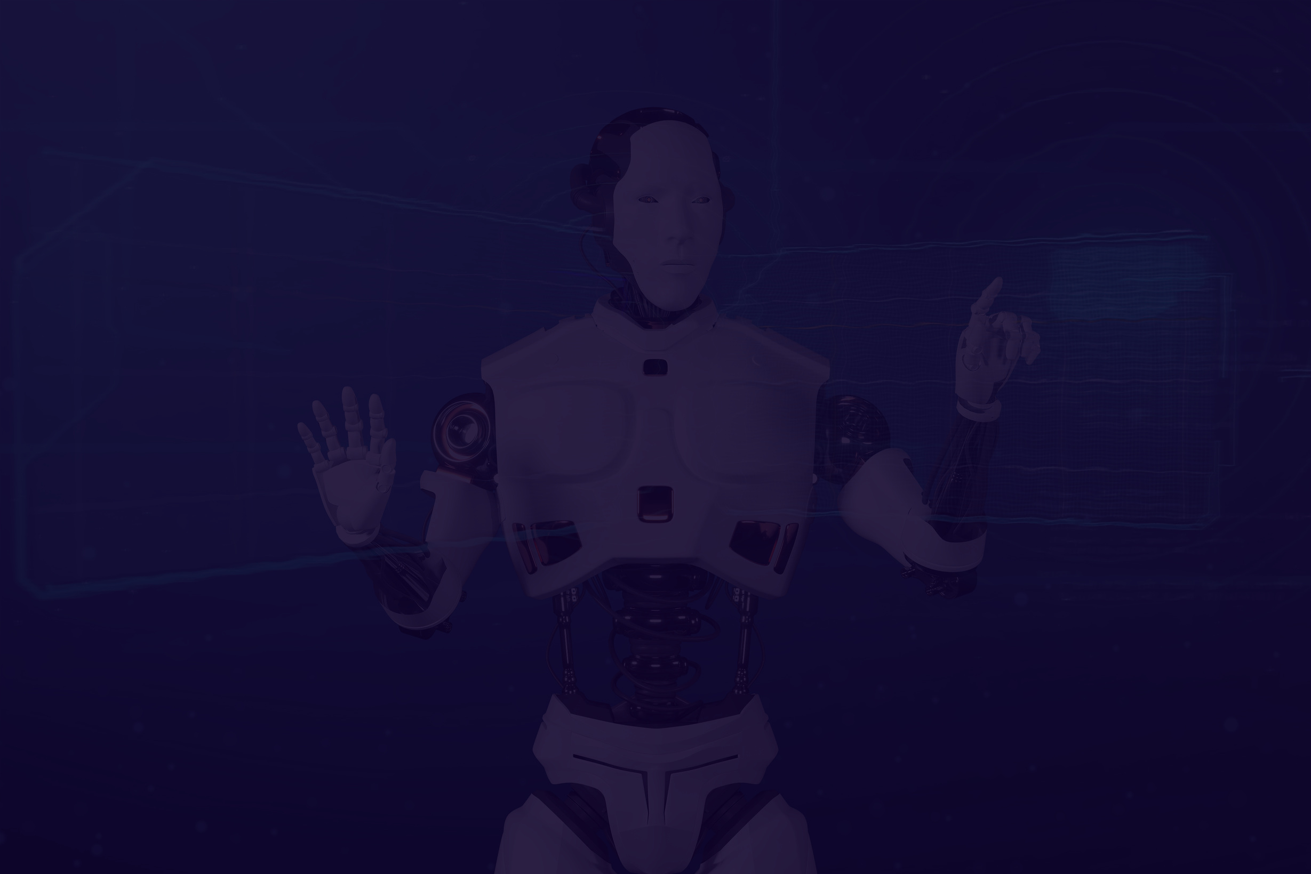
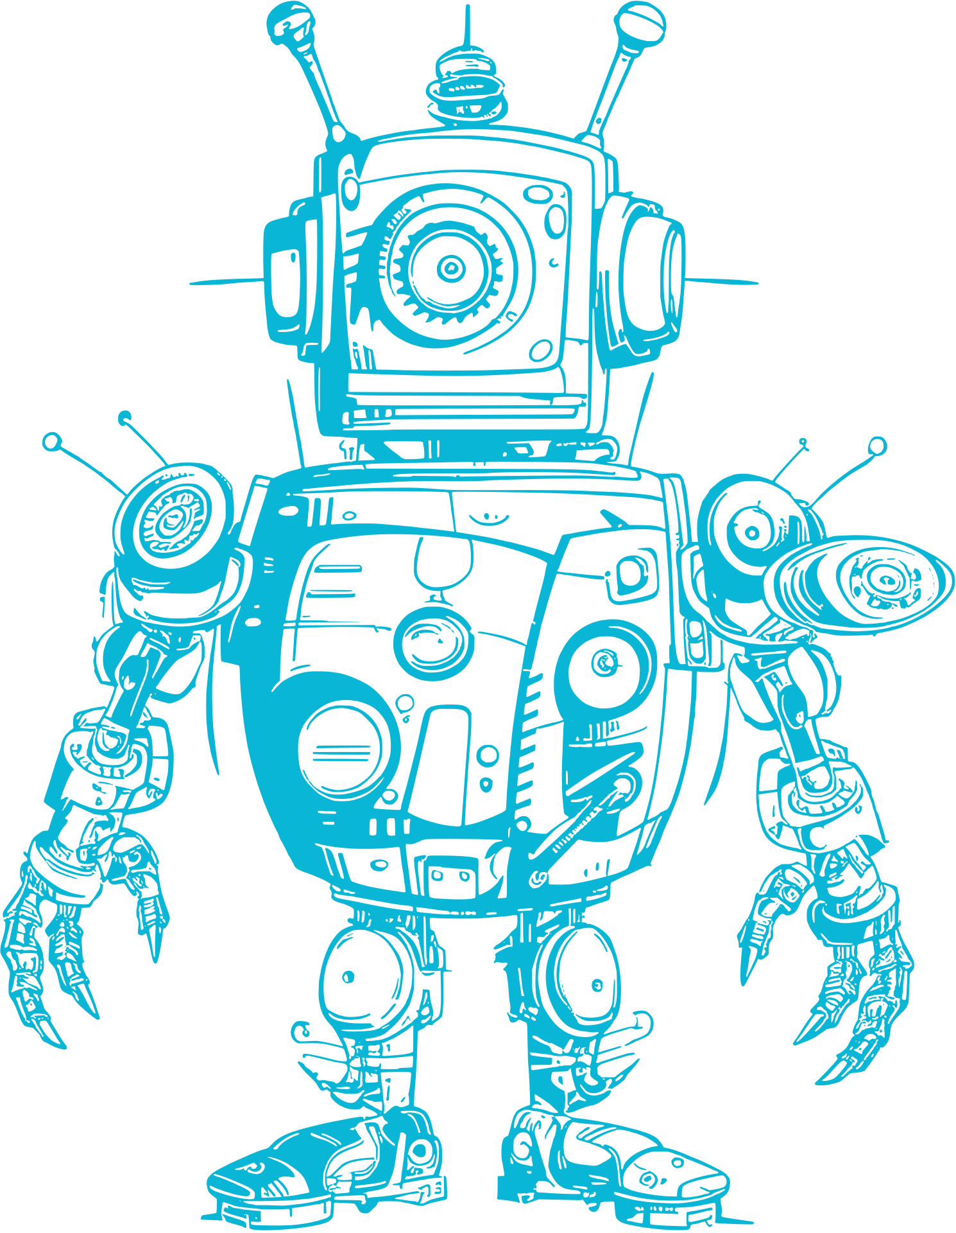

Project Overview
02
Objective:
Develop an AI-based model for detecting breast cancer using MRI images.
Goal:
Assist radiologists in early diagnosis with accurate predictions.
Approach:
Use deep learning techniques, including VGG16 and ResNet architectures.
Scope:
Data collection, preprocessing, model development, and evaluation.

Slide 3
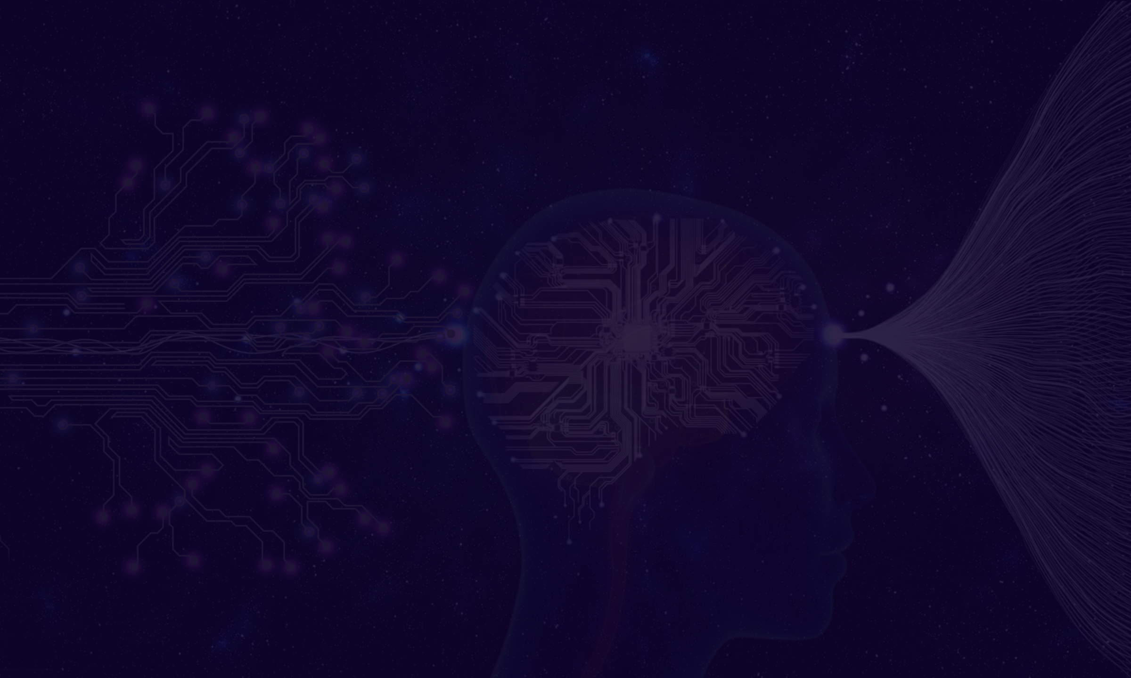

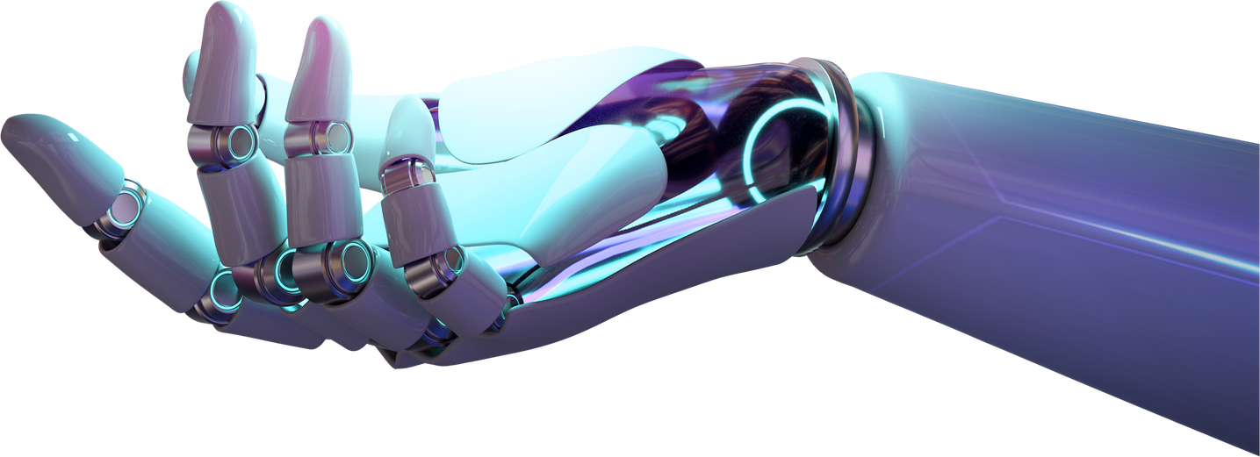
Problem Statement
Breast cancer is a leading cause of cancer-related deaths among women globally.
Early detection through imaging techniques like MRI can significantly improve prognosis and treatment outcomes.
Manual classification of MRI images is time-consuming and prone to errors.
The Tumor Trace project aims to develop an AI-based model for detecting breast cancer using MRI images. By leveraging deep learning techniques, the goal is to provide accurate predictions to assist radiologists in early diagnosis.
03

Slide 4


Methodology
04
Workflow:
Data Collection
Data Preprocessing
Model Development
Model Evaluation
Tools and Techniques:
Python, TensorFlow/Keras, PyTorch, Scikit-Learn, Gradio
Approach:
Utilize deep learning models, data augmentation, and advanced evaluation metrics.

Slide 5

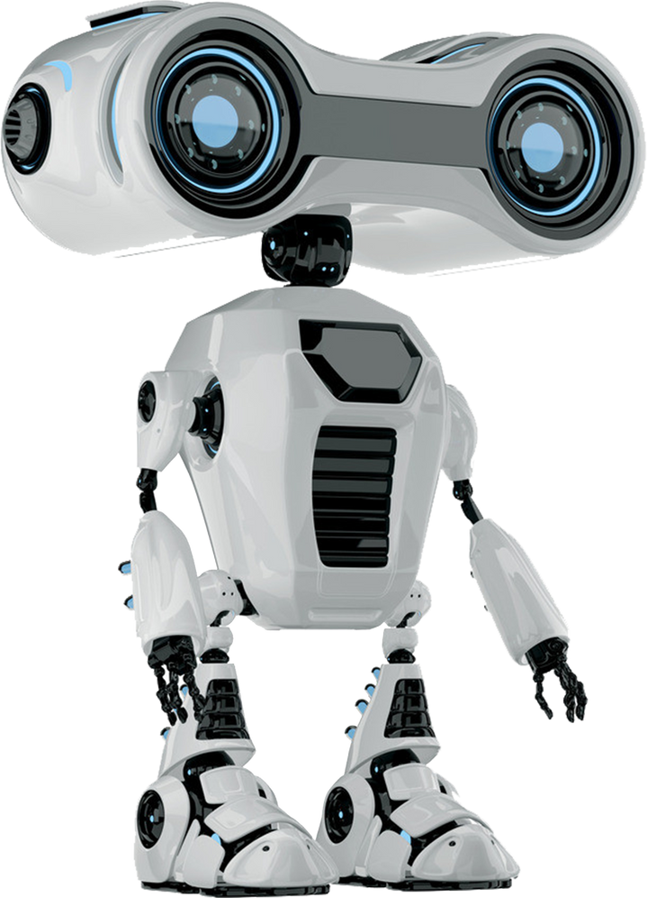
Data Collection and Preprocessing
05
Dataset:
MRI images labeled as malignant or benign.
Source: [Specify the source or database]
Preprocessing Steps:
Grayscale Conversion: Convert images to grayscale.
Resizing: Resize images to a standard dimension (e.g., 224x224).
Normalization: Normalize pixel values to a range suitable for neural network input.
Augmentation: Apply techniques such as rotation and flipping to augment the dataset.
Handling Class Imbalance: Use techniques like oversampling, undersampling, and class weights.

Slide 6
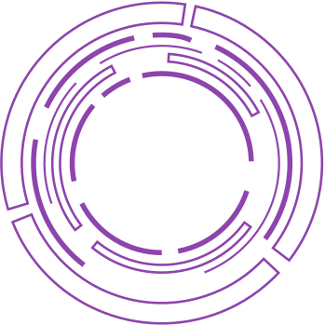
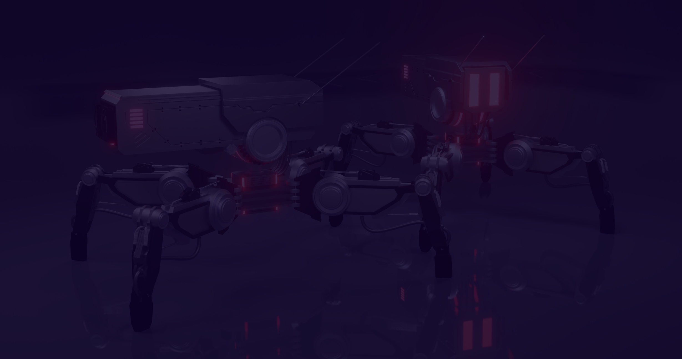

Model
Development
06
Models:
VGG16: A convolutional neural network with 16 layers.
ResNet18: A deeper architecture with residual learning for improved training.
ResNet50: An even deeper architecture for better performance.
Model Development:
Initialize pre-trained models.
Fine-tune on breast cancer dataset.
Train and validate models.
Visuals:
Diagrams of the VGG16, ResNet18, and ResNet50 architectures.
Example code snippets for model initialization and training.

Slide 7


Evaluation Metrics
07
Accuracy: Percentage of correct predictions.
Precision: Ability of the model to avoid false positives.
Recall: Ability of the model to identify actual positive
cases (sensitivity).
F1 Score: Harmonic mean of precision and recall.
AUC (Area Under Curve): Measures how well the model
distinguishes between benign and malignant tumors.
Confusion Matrix: Table that helps you understand the
performance of your classification. It shows the counts
of true positives, true negatives, false positives, and
false negatives.

Slide 8



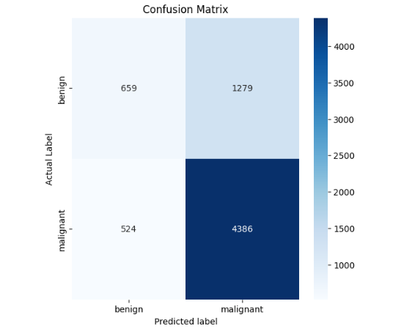
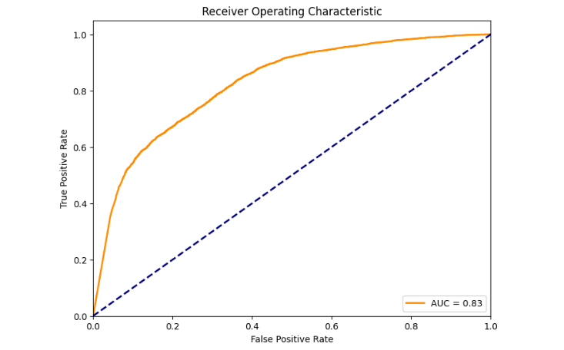
Result and Impact
VGG16 Model
Accuracy: 73.64%, AUC: 0.8257
Classification Report of Test :
precision recall f1-score support
benign 0.5571 0.3400 0.4223 1938
malignant 0.7742 0.8933 0.8295 4910
accuracy 0.7367 6848
macro avg 0.6656 0.6167 0.6259 6848
weighted avg 0.7128 0.7367 0.7143 6848
Specificity: 1.0000, Sensitivity: 0.0000, AUC: 0.8257
test set: Average loss: 0.0774, Accuracy: 5045/6851 (73.64%)

Slide 9


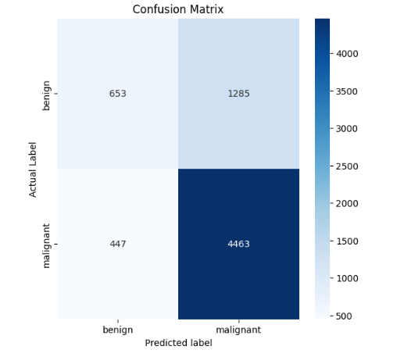
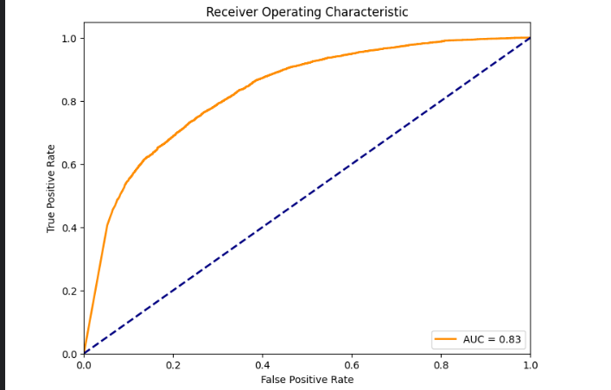
Result and Impact
RESNET18 Model
Accuracy: 74.68%, AUC: 0.8305
Classification Report of Test :
precision recall f1-score support
benign 0.5936 0.3369 0.4299 1938
malignant 0.7764 0.9090 0.8375 4910
accuracy 0.7471 6848
macro avg 0.6850 0.6230 0.6337 6848
weighted avg 0.7247 0.7471 0.7221 6848
Specificity: 1.0000, Sensitivity: 0.0000, AUC: 0.8305
test set: Average loss: 0.0834, Accuracy: 5116/6851 (74.68%)

Slide 10


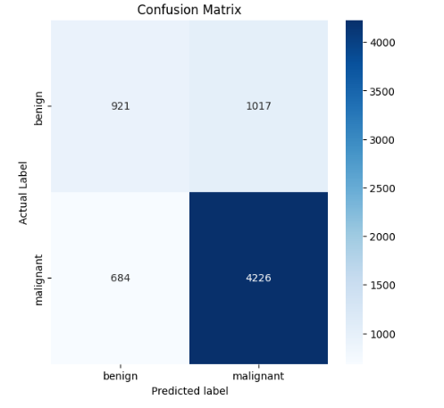
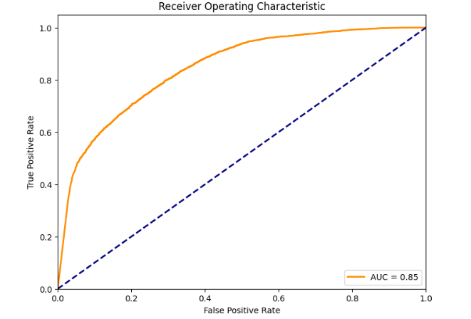
Result and Impact
RESNET50 Model
Accuracy: 75.13%, AUC: 0.8458
Classification Report of Test :
precision recall f1-score support
benign 0.5738 0.4752 0.5199 1938
malignant 0.8060 0.8607 0.8325 4910
accuracy 0.7516 6848
macro avg 0.6899 0.6680 0.6762 6848
weighted avg 0.7403 0.7516 0.7440 6848
Specificity: 1.0000, Sensitivity: 0.0000, AUC: 0.8458
test set: Average loss: 0.0615, Accuracy: 5147/6851 (75.13%)

Slide 11
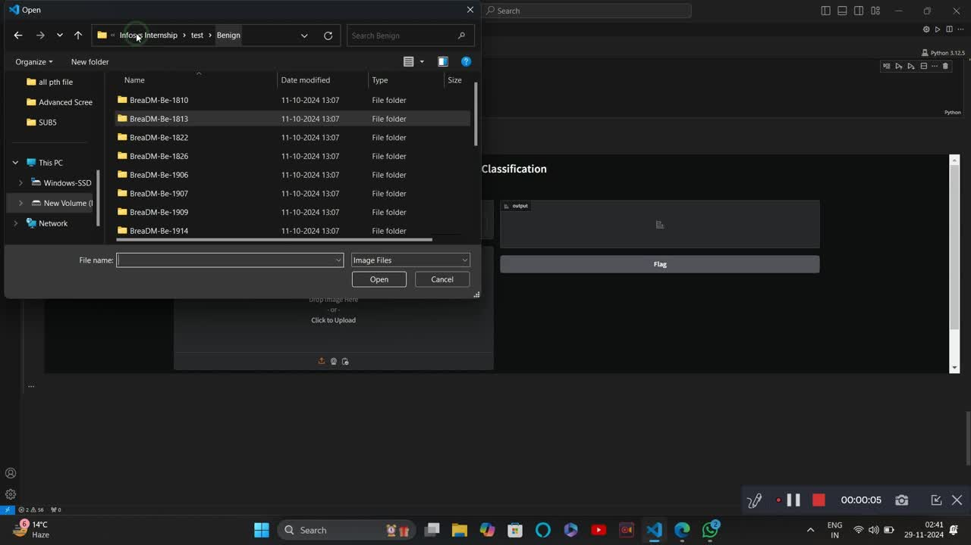
Result and Impact

Slide 12
THANK YOU !

